Slide 1
Who Is Information Security For ?
Personal:
Social media passwords and safe usage
Online banking and email account passwords
Home PC/laptop security
Mobile security

Slide 2
Who Is Information Security For ?
Organizational:
Board and executive leadership (management commitment)
CISO (responsible to drive security program)
IT staff and business users (following information security policies & procedures)

Slide 3
Who Is Information Security For ?
Govt and national:
Law enforcement
Legal and policy making
National database
Critical infrastructure
Regulation
Standards and certification
Capacity-building and coordination

Slide 4
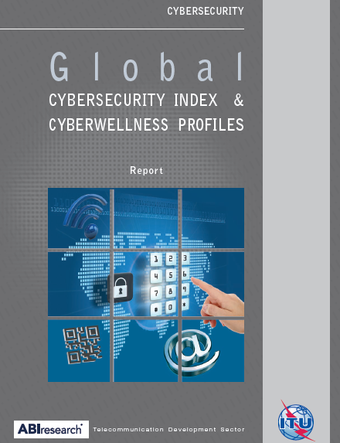
Who Is Information Security For ?
Legal
Technical
Organizational
Capacity building
Cooperation

Slide 5
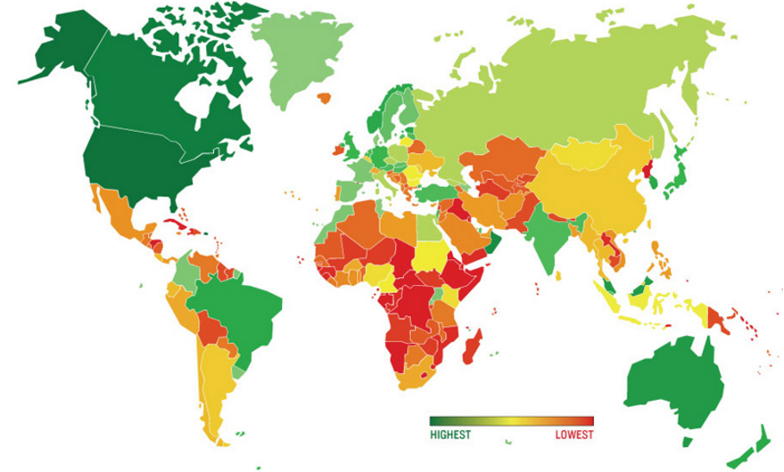
Who Is Information Security For ?

Slide 6
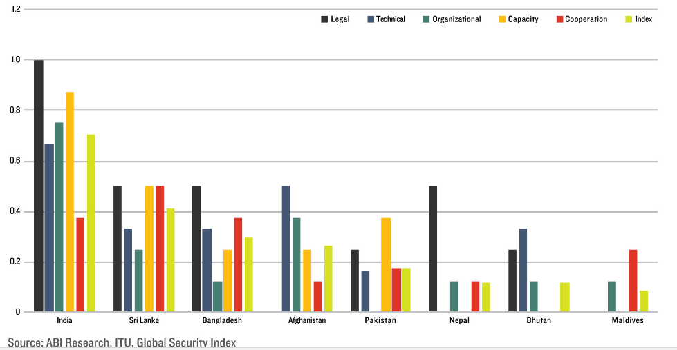
Who Is Information Security For ?

Slide 7
Who Is Information Security For ?
Pakistan ranked almost at the bottom of the table in International ranking by ITU
Information security is everyone’s responsibility
Pakistan Cyber Security Association (PCSA) formed to address Pakistan’s international ranking
END

